Slide 1

PROJECT PRESENTATION
PRESENTED BY JESWIN THOMAS

Slide 2
BLOCK DIAGRAM
import libraries
upload dataset
data preprocessing and encoding
data visualisation
model evaluation
model training
correlation heatmap

Slide 3
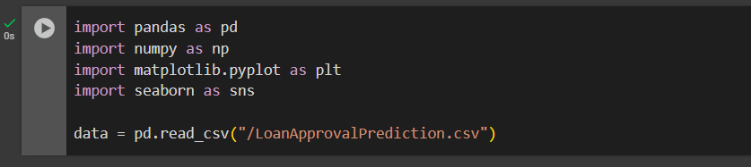
IMPORT LIBRARIES AND READ

Slide 4
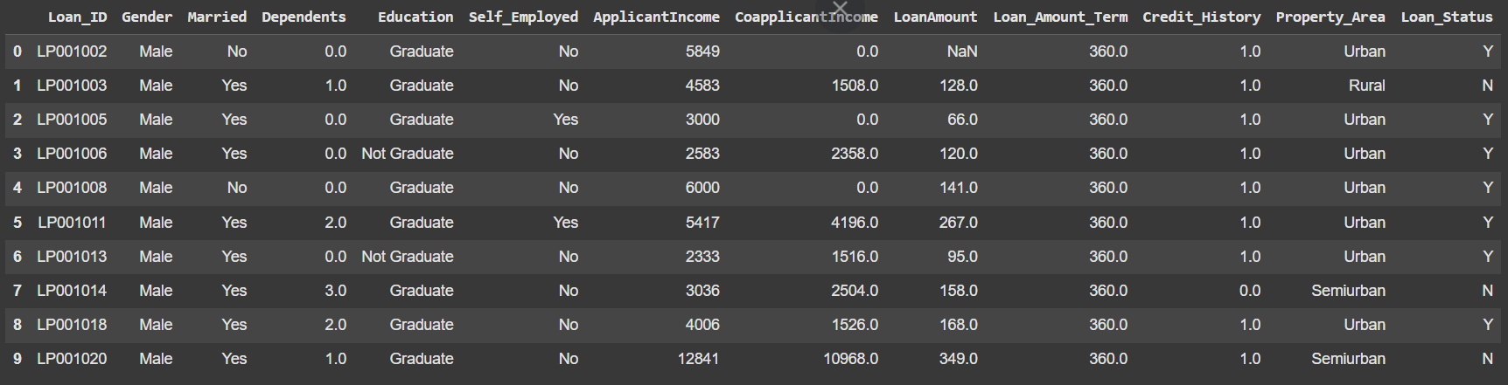
READ DATASET

Slide 5
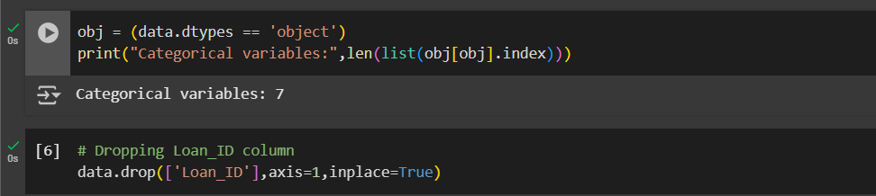
DATA PREPROCESSING

Slide 6
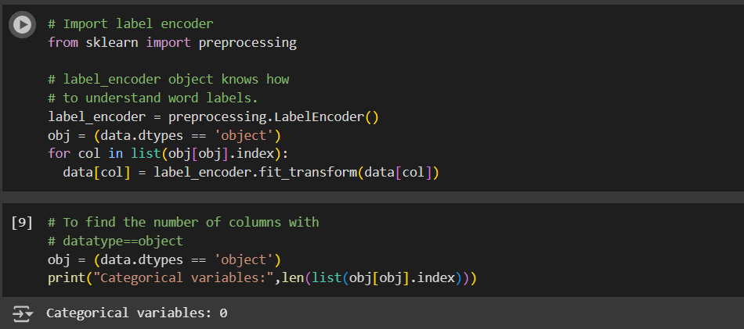
DATA ENCODING

Slide 7
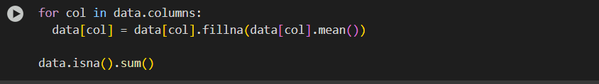
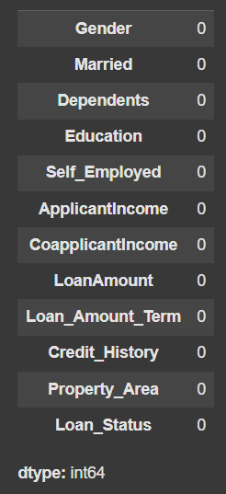
MISSING VALUES IN THE DATASET

Slide 8
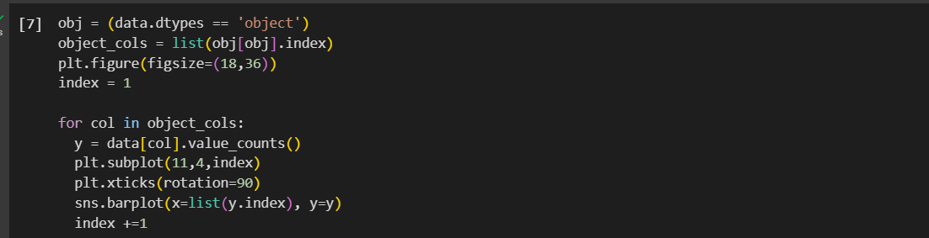
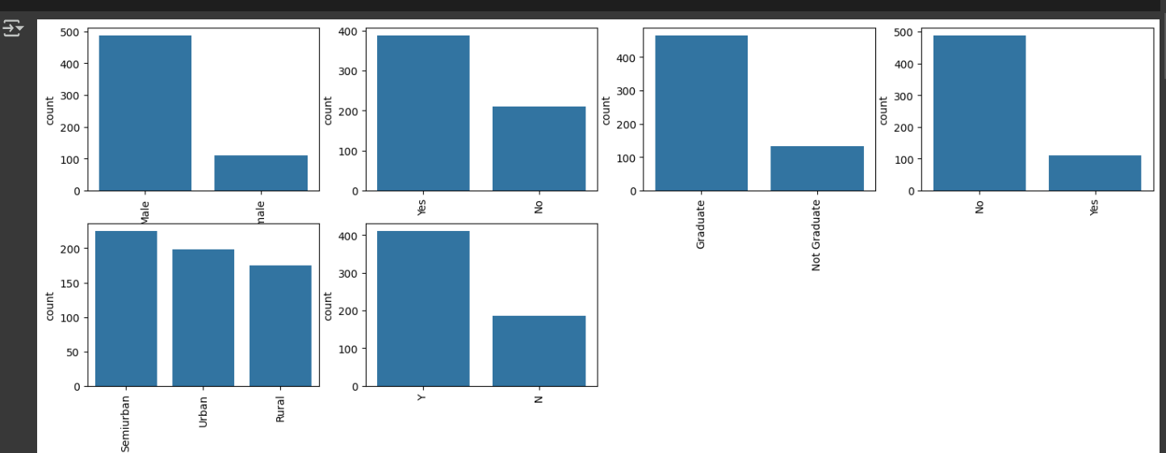
VISUALISATION

Slide 9
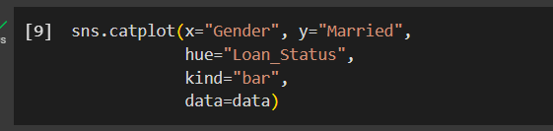
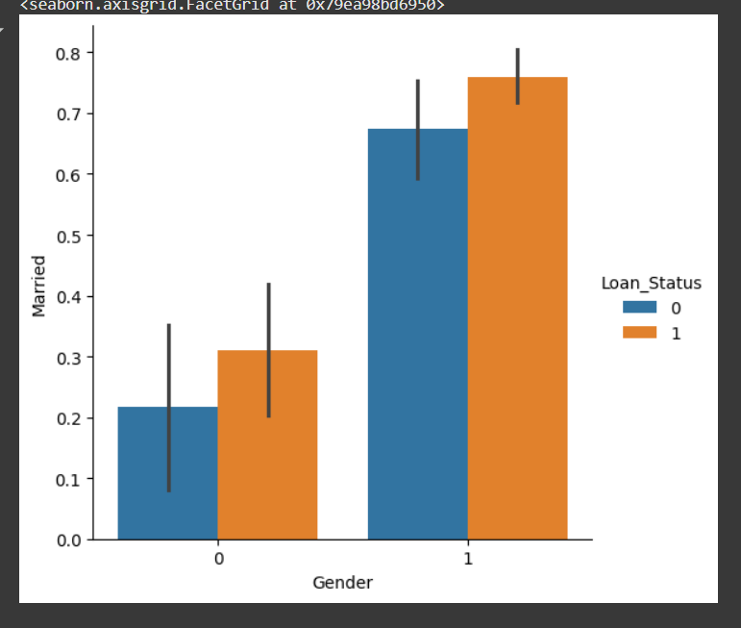
PLOT FOR GENDER AND MARTIAL STATUS

Slide 10
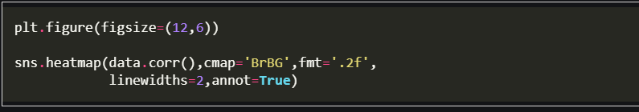
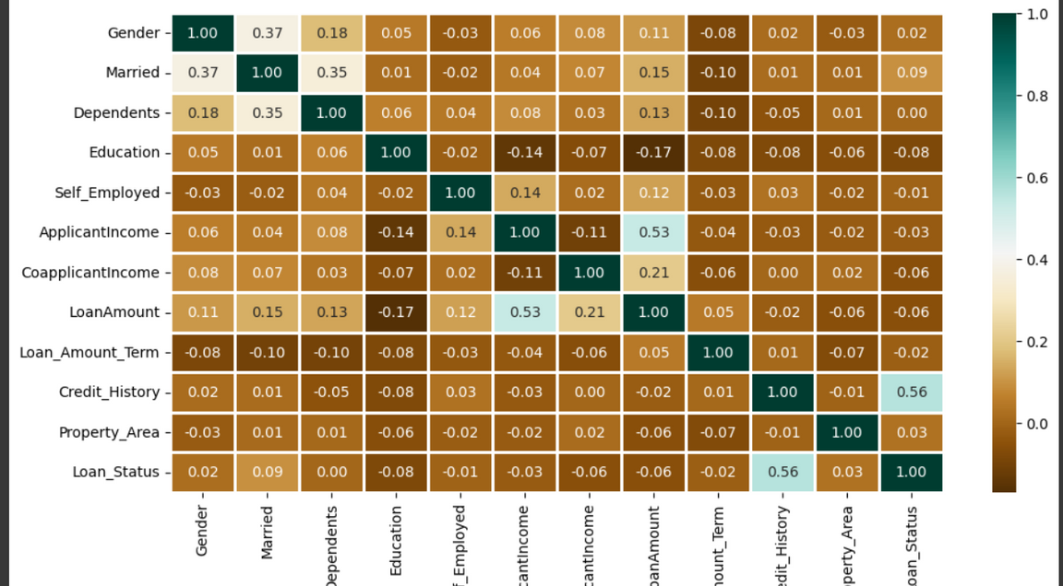
CORRELATION HEATMAP

Slide 11
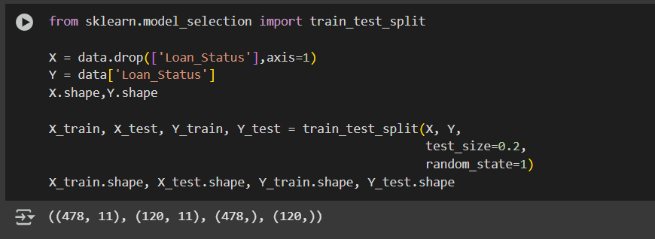
SPLITTING DATASET

Slide 12
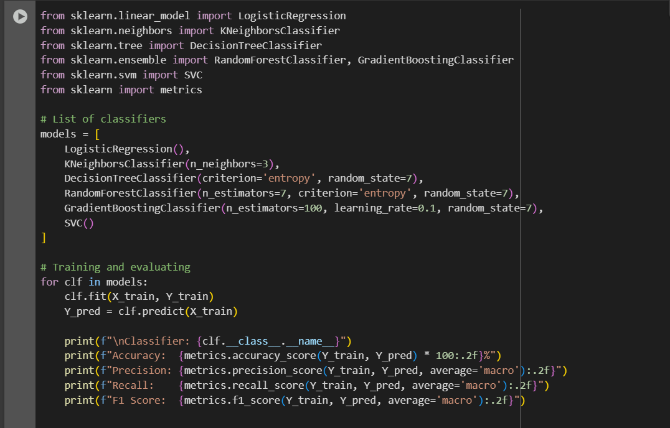
MODEL TRAINING

Slide 13
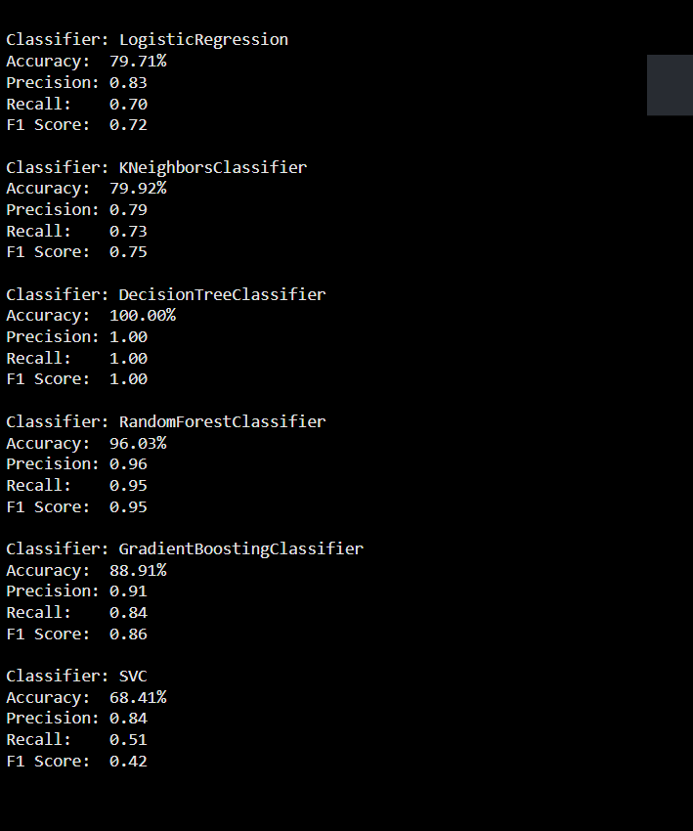

Slide 14
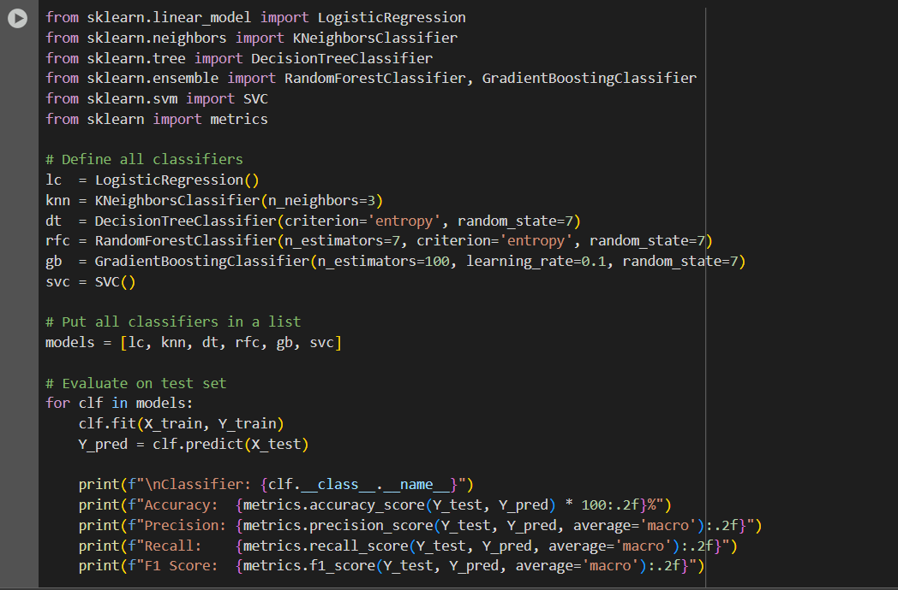
MODEL EVALUATION

Slide 15
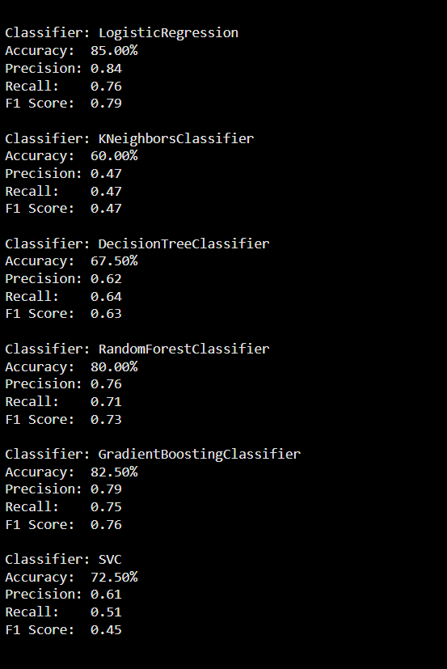

Slide 16
Thank you very much!
PRESENTED BY JESWIN THOMAS

